Slide 1
Computing Scattering Intensities with Sassena
SHUG-15
Jose M. Borreguero & Vickie E. Lynch
Neutron Data Analysis and Visualization Division
Center for Accelerating Materials Modelling

Slide 2

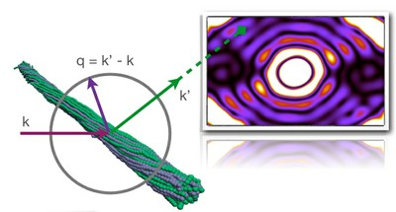
What is ?
“Sassena is a highly scalable parallelized software for calculating neutron and X-ray scattering intensities from molecular dynamics simulations.”
http://www.sassena.org/

Slide 3
Contents
What does Sassena compute?
Features
Reference

Slide 4
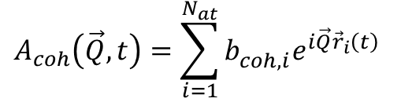
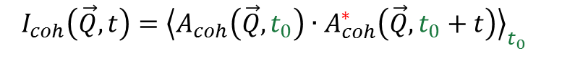
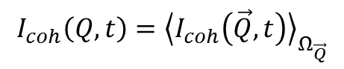
Coherent Scattering
Coherent intermediate (time-dependent) dynamic structure factor
(Collective motion)
$$A_{coh}\left(\vec{Q},t\right)=\sum_{i=1}^{N_{at}}{b_{coh,i}^{}e^{i\vec{Q}{\vec{r}}_{i}\left(t\right)}}$$
system amplitude, for
every trajectory frame
crystal (phonons)
cell membrane
anisotropic system
$$I_{coh}\left(\vec{Q},t\right)={{\left\langle A_{coh}\left(\vec{Q},t_{0}\right)∙A_{coh}^{∗}\left(\vec{Q},t_{0}+t\right)\right\rangle }_{t_{0}}}_{}$$
solvent
micro-crystalline powder
isotropic system
$$I_{coh}\left(Q,t\right)={\left\langle I_{coh}\left(\vec{Q},t\right)\right\rangle }_{Ω_{\vec{Q}}}$$

Slide 5
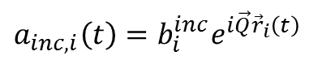
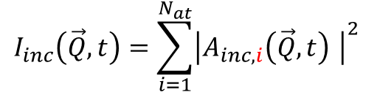
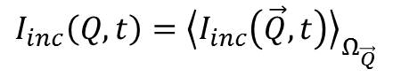
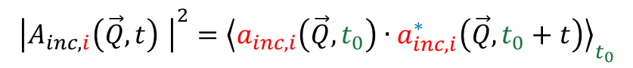
Incoherent scattering
Incoherent intermediate (time-dependent) dynamic structure factor
(self -motion)
$$a_{inc, i}\left(t\right)=b_{i}^{inc}e^{i\vec{Q}{\vec{r}}_{i}\left(t\right)}$$
$${\left|A_{inc,i}\left(\vec{Q},t\right) \right|}^{2}={\left\langle a_{inc,i}\left(\vec{Q},t_{0}\right)∙a_{inc,i}^{∗}\left(\vec{Q},t_{0}+t\right)\right\rangle }_{t_{0}}$$
intensity for each atom
$$I_{inc}\left(\vec{Q},t\right)=\sum_{i=1}^{N_{at}}{{\left|A_{inc,i}\left(\vec{Q},t\right) \right|}^{2}}$$
anisotropic diffusion under external field
solvent
crystalline powder
isotropic system
$$I_{inc}\left(Q,t\right)={\left\langle I_{inc}\left(\vec{Q},t\right)\right\rangle }_{Ω_{\vec{Q}}}$$

Slide 6
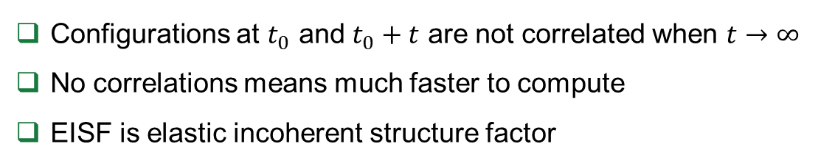
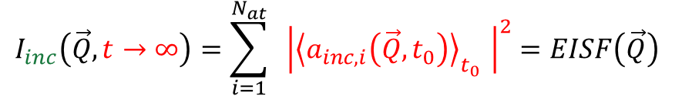
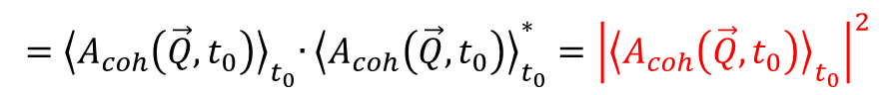
Long Time Value
Configurations at $t_{0}$ and $t_{0}+t$ are not correlated when $t→∞$
No correlations means much faster to compute
EISF is elastic incoherent structure factor
$$I_{coh}\left(\vec{Q},t→∞\right)={{\left\langle A_{coh}\left(\vec{Q},t_{0}\right)∙A_{coh}^{∗}\left(\vec{Q},t_{0}+t\right)\right\rangle }_{t_{0}}→{\left\langle A_{coh}\left(\vec{Q},t_{0}\right)\right\rangle }_{t_{0}}∙{\left\langle A_{coh}^{∗}\left(\vec{Q},t_{0}+t\right)\right\rangle }_{t_{0}}=}_{}$$
$${=\left\langle A_{coh}\left(\vec{Q},t_{0}\right)\right\rangle }_{t_{0}}∙{\left\langle A_{coh}\left(\vec{Q},t_{0}\right)\right\rangle }_{t_{0}}^{∗}={\left|{\left\langle A_{coh}\left(\vec{Q},t_{0}\right)\right\rangle }_{t_{0}}\right|}^{2}$$
Diffraction
$$I_{inc}\left(\vec{Q},t→∞\right)=\sum_{i=1}^{N_{at}}{{ \left|{\left\langle a_{inc,i}\left(\vec{Q},t_{0}\right)\right\rangle }_{t_{0}} \right|}^{2}}=EISF\left(\vec{Q}\right)$$
Fast experiment (<1hour)

Slide 7
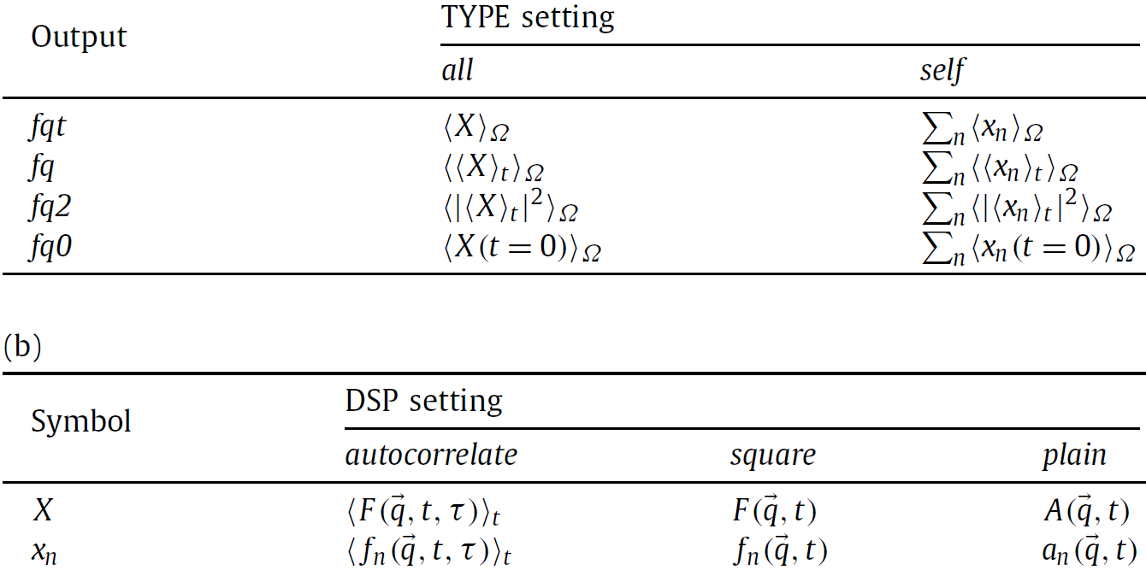
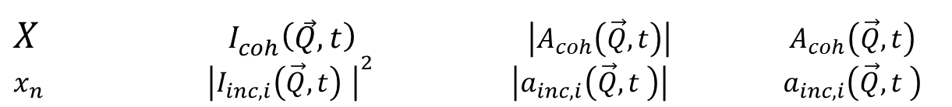
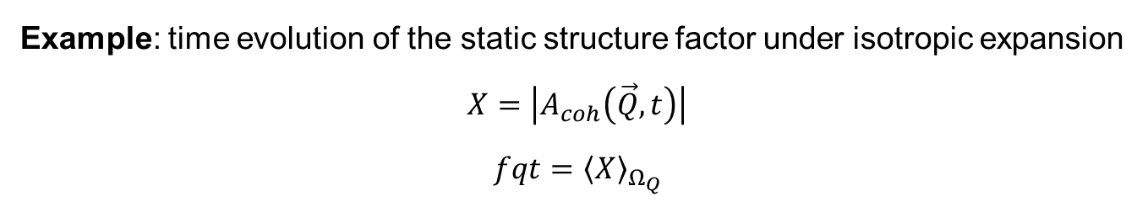
Summary
correlation intensity amplitude
real real complex
$X I_{coh}\left(\vec{Q},t\right)$ $\left|A_{coh}\left(\vec{Q},t\right)\right| A_{coh}\left(\vec{Q},t\right)$
$x_{n}$ ${\left|I_{inc,i}\left(\vec{Q},t\right) \right|}^{2}$ $\left|a_{inc,i}\left(\vec{Q},t \right)\right|$ $a_{inc,i}\left(\vec{Q},t \right)$
coherent
incoherent
Example: time evolution of the static structure factor under isotropic expansion
$$X=\left|A_{coh}\left(\vec{Q},t\right)\right|$$
$$fqt={\left\langle X\right\rangle }_{Ω_{Q}}$$

Slide 8
Advantages and Disadvantages
Linearly scale up to 7000 cores
Handles millions of atoms
Developers are at ORNL
Not for windows computers
→ However cygwin, or virtual machine
Not easy to install
Input configuration file, no GUI ?

Slide 9
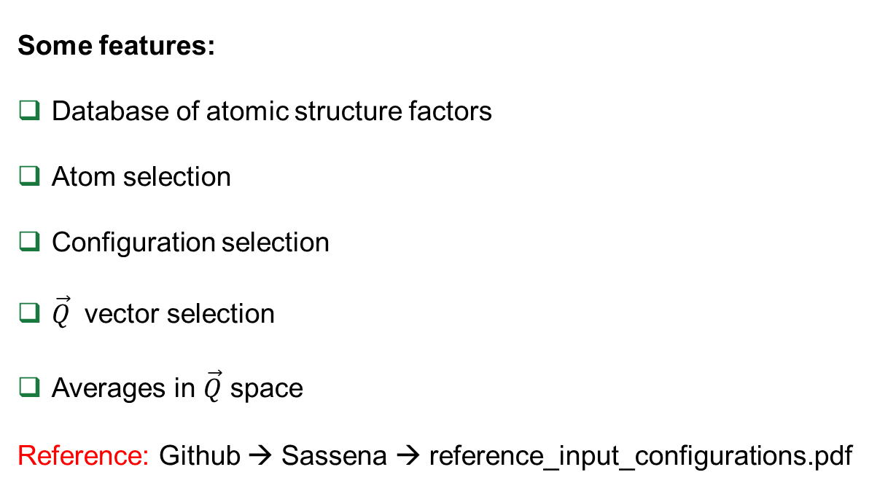
Input Options
All input options are specified in a single file
Walkthrough: Github → sassena → input_example.xml
Some features:
Database of atomic structure factors
Atom selection
Configuration selection
$\vec{Q}$ vector selection
Averages in $\vec{Q}$ space
Reference: Github → Sassena → reference_input_configurations.pdf

Slide 10
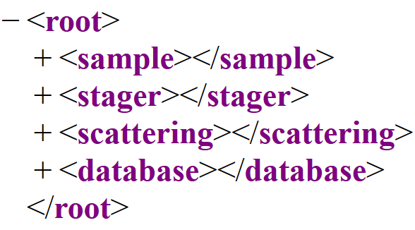
Input Options
All input options are specified in a single file
Walkthrough: Github → sassena → input_example.xml
← Options for the input data
← Algorithm to carry out the number crunching
← Options for the type of scattering
← Atomic structure factors

Slide 11
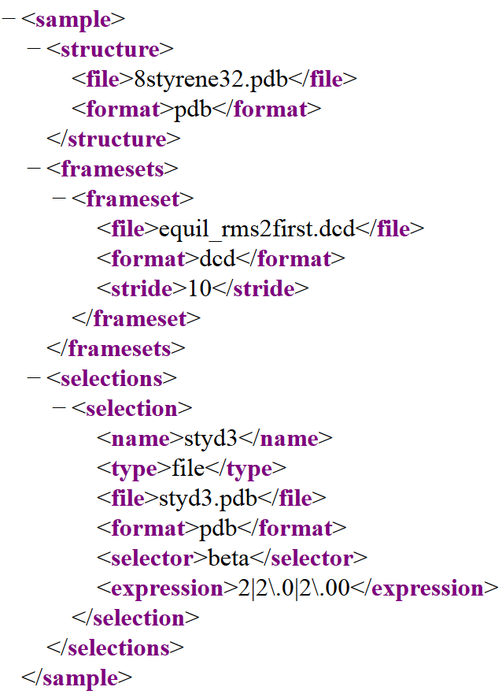
Sample Section
← List of atom names
← atomic trajectory
← atom selection

Slide 12
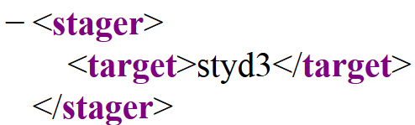
Stager Section
← relevant subsystem

Slide 13
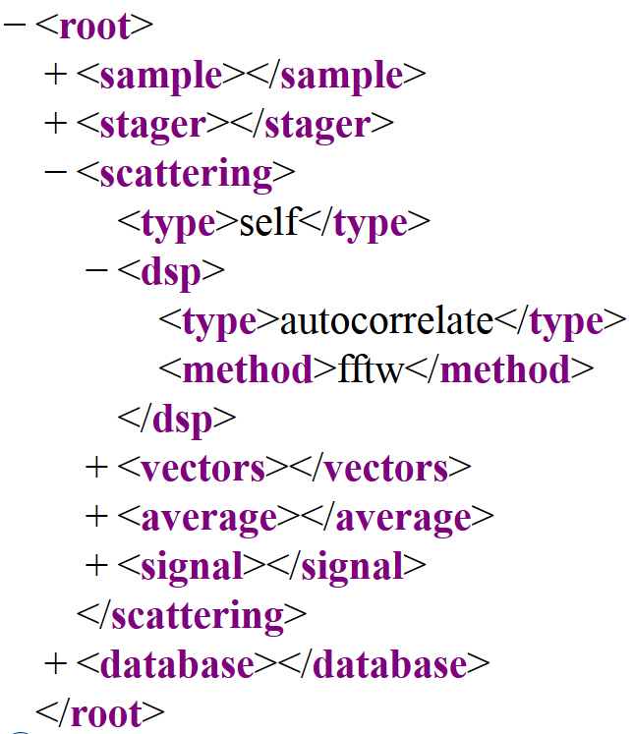
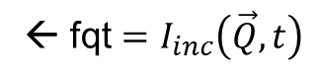
Scattering Section
← Incoherent (all for coherent)
← fqt $=I_{inc}\left(\vec{Q},t\right)$

Slide 14
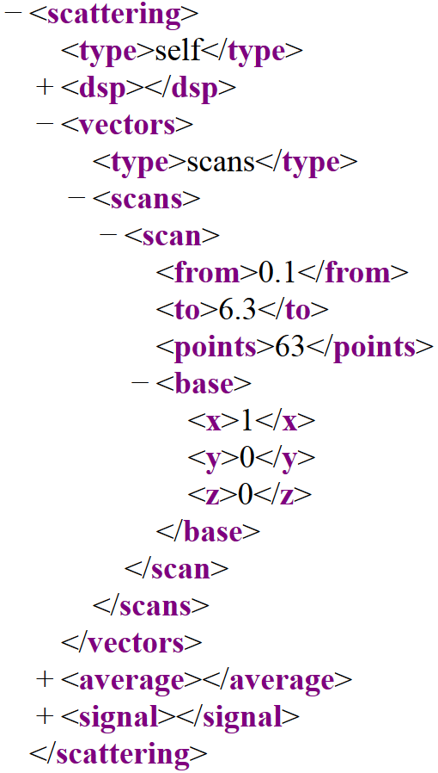
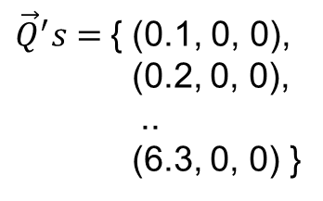
Scattering.Vectors
← List of vectors for which to compute $I_{inc}\left(\vec{Q},t\right)$
${\vec{Q}}^{′}s=${ (0.1, 0, 0),
(0.2, 0, 0),
..
(6.3, 0, 0) }

Slide 15
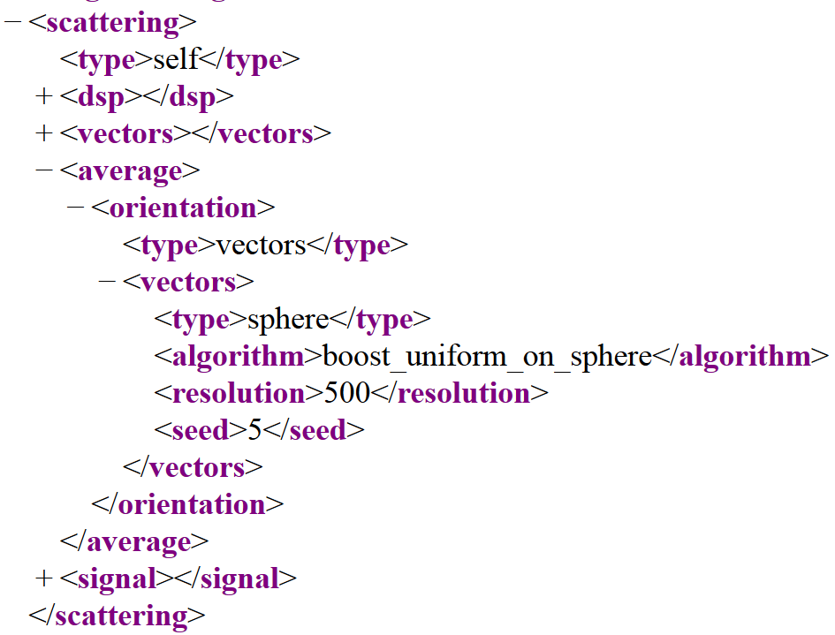
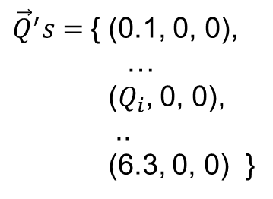
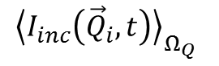
Scattering.average
${\vec{Q}}^{′}s=${ (0.1, 0, 0),
…
($Q_{i}$, 0, 0),
..
(6.3, 0, 0) }
$Q_{i}∙\left(sinθ_{1}cosφ_{1},sinθ_{1}sinφ_{1},cosθ_{1}\right)$ → $I_{inc}\left({\vec{Q}}_{i,1},t\right)$
$Q_{i}∙\left(sinθ_{2}cosφ_{2},sinθ_{2}sinφ_{2},cosθ_{2}\right)$ → $I_{inc}\left({\vec{Q}}_{i,2},t\right)$
…
$Q_{i}∙\left(sinθ_{N}cosφ_{N},sinθ_{N}sinφ_{N},cosθ_{N}\right)$ → $I_{inc}\left({\vec{Q}}_{i,N},t\right)$
$${\left\langle I_{inc}\left({\vec{Q}}_{i},t\right)\right\rangle }_{Ω_{Q}}$$

Slide 16
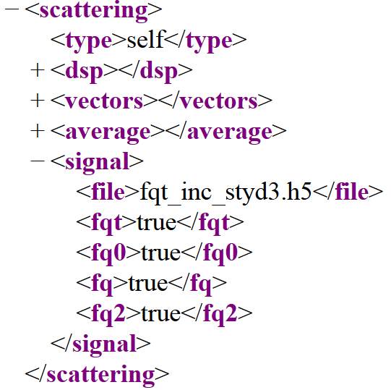
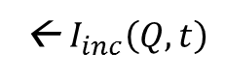
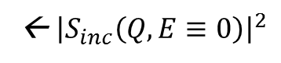
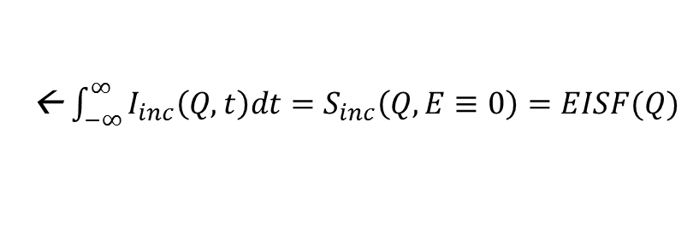
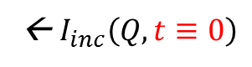
Scattering.signal
← Single output file
← $I_{inc}\left(Q,t\right)$
← $I_{inc}\left(Q,t≡0\right)$
← ${\int_{−∞}^{∞}{I_{inc}\left(Q,t\right)dt}=S}_{inc}\left(Q,E≡0\right)=EISF(Q)$
← ${\left|S_{inc}\left(Q,E≡0\right)\right|}^{2}$

Slide 17
Reference and Guide
Reference:
B. Lindner and J. C. Smith, Computer Physics Communications 183 (7) 1491-1501
Github → sassena →reference_paper.pdf
Guide:
Github → sassena → reference_input_configurations.pdf

Slide 18
Running example
cd ~/SHUG2015/sassena/examples/styrene
module load sassena
sassena --config=sassenaInc.xml
Serial run takes 1564s (24.4 min)
Output is fqt_inc_styd3.h5, 876Kb hdf5 file
mpirun -np 16 sassena --config=sassenaInc.xml >& Inc.out
Log output is in Inc.out
Parallel run finishes in 100s (1564s/16cores = 98s)
With 32 cores it is 61s

Slide 19
Example Batch Script for Hopper
#!/bin/bash #PBS -A m1503 #PBS -N sassena #PBS -j oe #PBS -l walltime=30:00 #PBS -l mppwidth=16 #PBS -q regular
cd $PBS_O_WORKDIR aprun -n 16 /global/project/projectdirs/m1503/camm/sassena-v1.4.1/builds/head/sassena --config=sassenaInc.xml >& Inc.out

